Slide 1

Predicting Customer Lifetime Value (CLV)
Anand Sagar Pandrapagada 11197418

Slide 2
Introduction
Success of business is directly proportional to its ability to acquire customers, solve their issues , and make more money.
To build a model that predicts customer Lifetime Value, which is amount of revenue that a customer spends on the business over the lifetime of their relationship
Scope:
With this project, business can find out the right potential customers.
Also, EDA is carried out how customers respond to market strategies and help business in their decision making.

Slide 3
Tools
Python Jupyter Notebook
Pandas, Seaborn libraries
Tableau for data visualization
Excel for Data Cleaning

Slide 4
Data description
Auto insurance company customer data
with 24 columns and 10k rows
Acquired from Kaggle

Slide 5
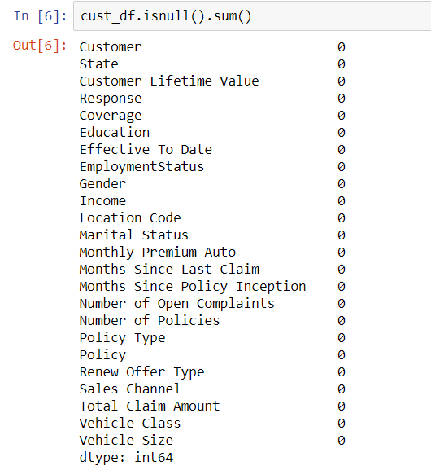
Data Cleaning
With the initial data being in CSV format, column “Vehicle size” has got some unnatural value #name. To replace this, I have observed the frequency of the values, out of which vehicle size “medium” has appeared around 7000 times out of 9500 rows. So, replaced those with Medium.
Also, in this phase, made note of those columns like “ effective date”, and “Location” etc which has nothing to do with our target variable and to remove them later.

Slide 6
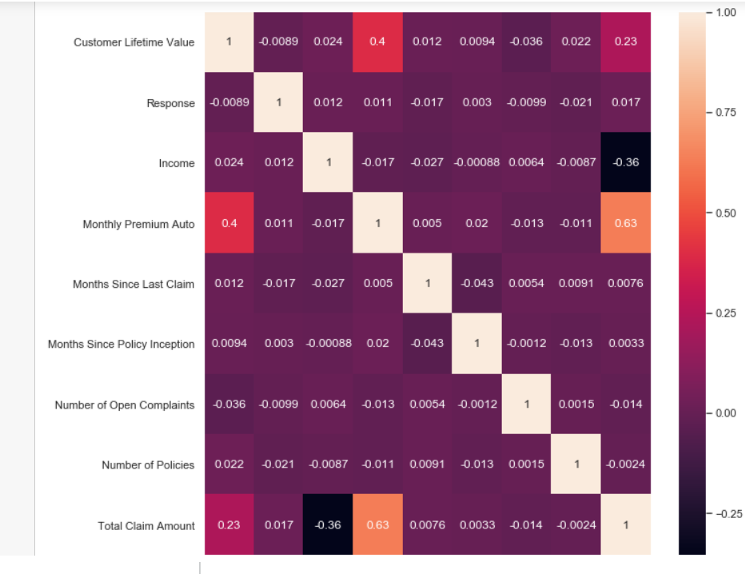
Exploratory Data Analysis
Numerical data
It reveals that Monthly premium Auto, Income, total claim amount has major effect on CLV, with being number of policies and number of open complaints has minor effects.

Slide 7
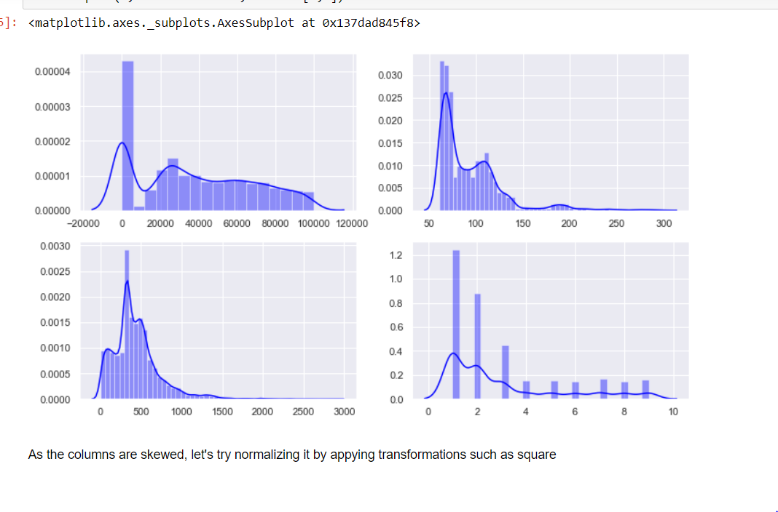
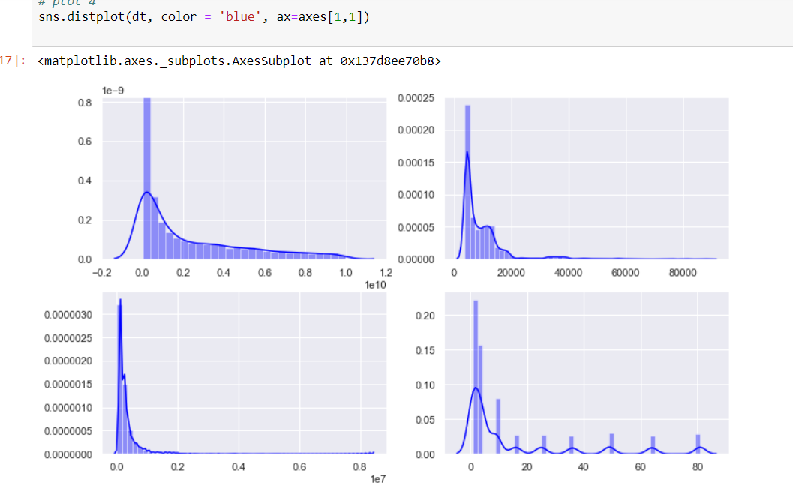
Exploratory Data Analysis - cont
Applied normalizing the data by applying square transformations, but resulted in more peaks and increased skewness

Slide 8
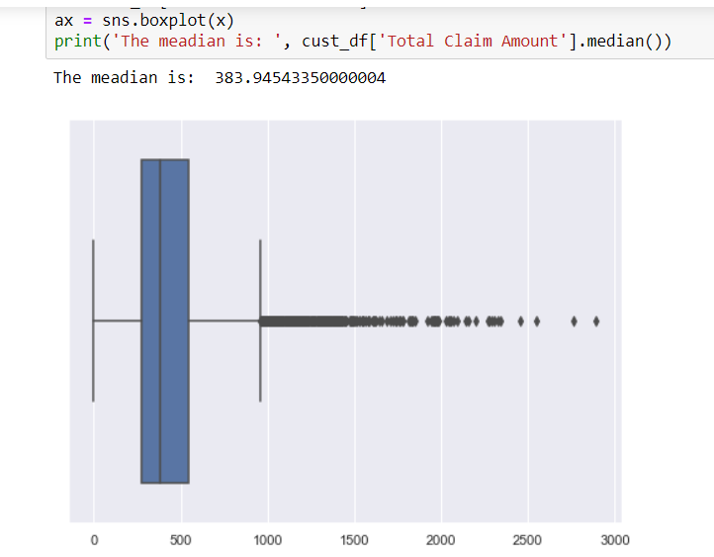
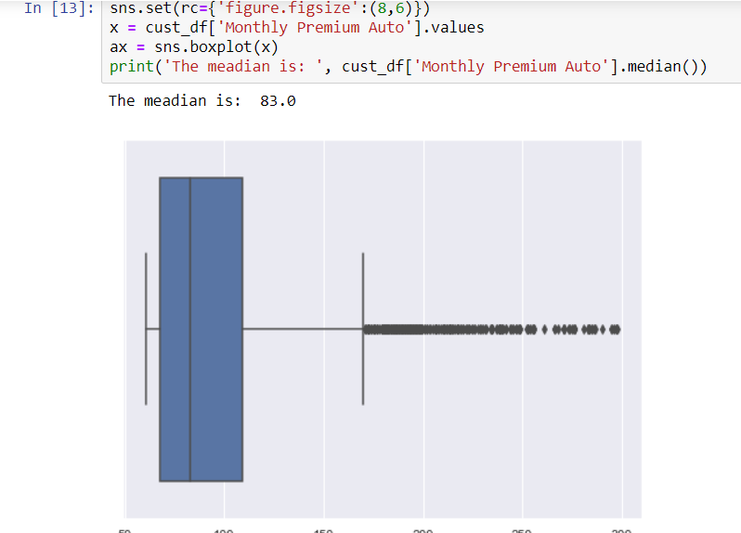
Exploratory data analysis - cont
There were some outliers in those columns, but removing those could lead to loss of potential customers
Decided to stick with the original data
Key: With this EDA, Monthly premium auto ( i.e., which we pay in installments to insurance provider for coverage), and total claim amount( i.e., the amount which can be claimed from insurance provider), and customers income has impact on CLV, which seems meaningful.

Slide 9
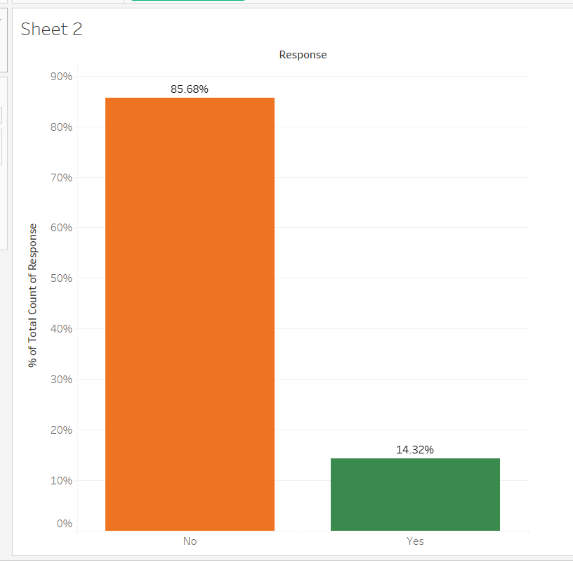
Data Visualization
Engagement Rate overall
For this insurance company the overall response rate is low, and key changes have to be made to make the customers respond to company’s strategies.

Slide 10
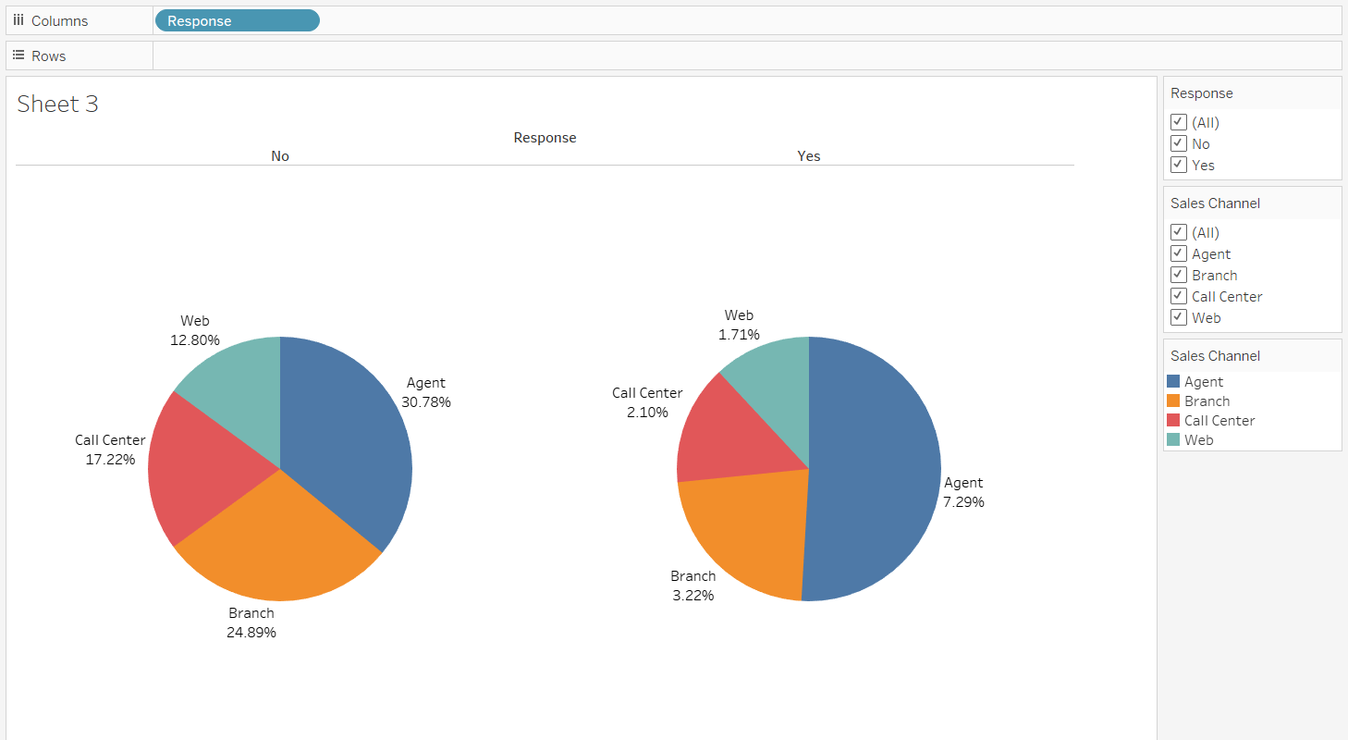
Data Visualization - 2
By what means insurance company is reaching to customers?( Engagement rate w.r.t sales channel)
So, my key finding here is that if the company takes steps by reaching customers by in person ( Agent and branch) rather than virtual( web and call center), it can definitely observe increase in response rate.

Slide 11
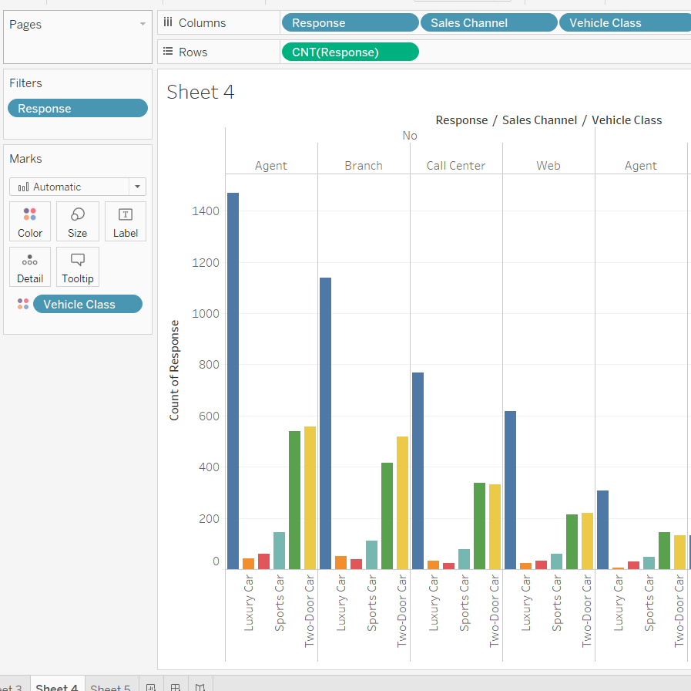
Data Visualization - 3
Response rate w.r.t Sales channel and Vehicle class
It says customers with four door and SUV, respond higher when contacted through Agent and branch.

Slide 12
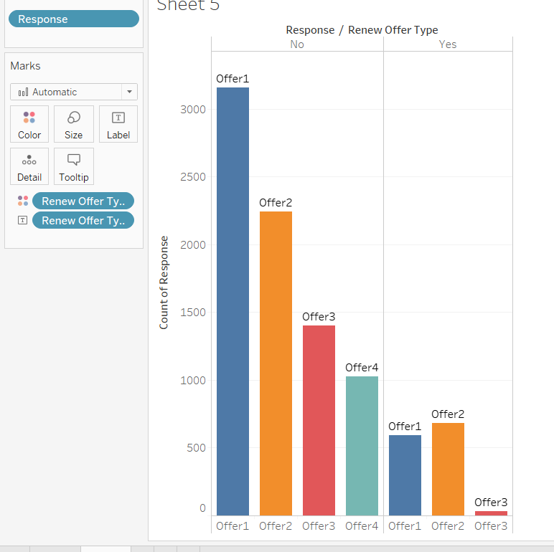
Data Visualization 4
Engagement rate w.r.t offer type
There are certain offers which company offers to its customers. As offer 3 and offer 4 are negligible, offering more on 1 and 2 will bring a significant impact.

Slide 13
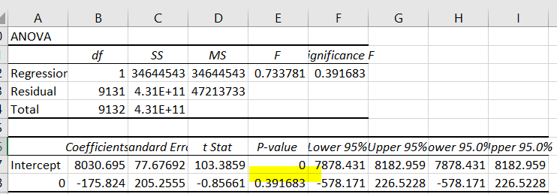
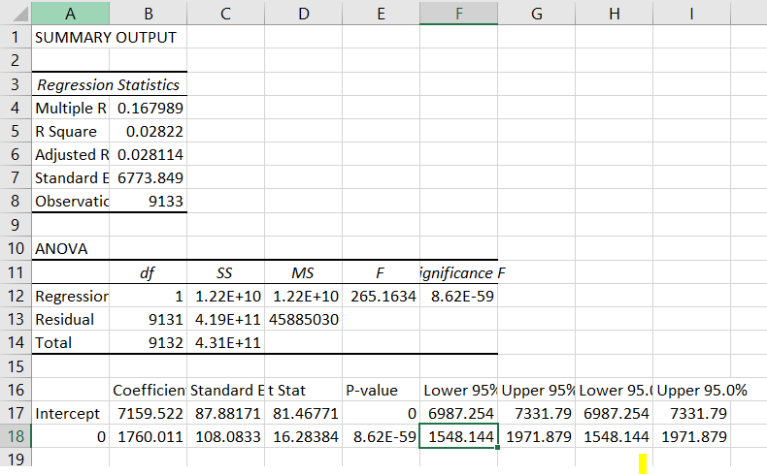
Feature Selection( Categorical Variables)
Used various techniques for this, such as hypothesis tests and python(seaborn) visualizations to select the features that impact our target variable.
Anova for response and coverage variables with CLV
Null hypothesis: Response has significant effect on CLV.
Alternate hypothesis: Response has no effect on CLV, it is only by random chance.
Here the p-value is greater than the significant value 0.05, which conveys that this feature is not significant.
Similarly, for coverage variable the p-value is far less than significance value 0.05, which means that this feature is significant.

Slide 14
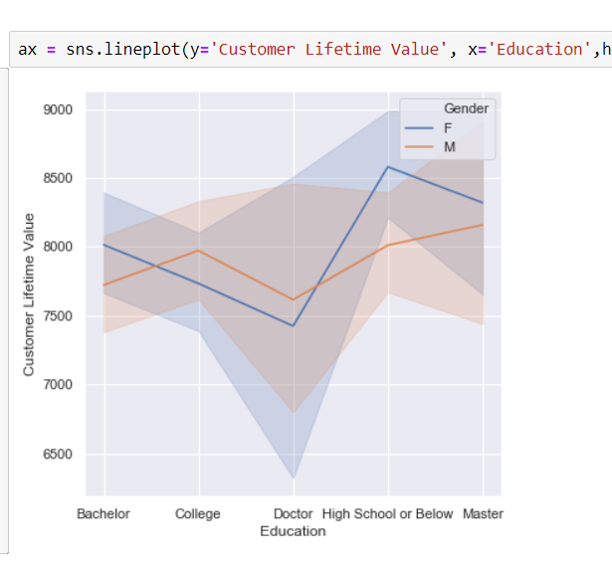
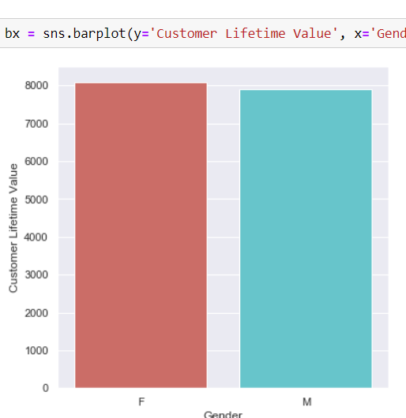
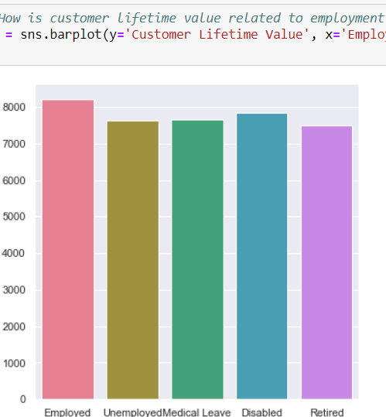
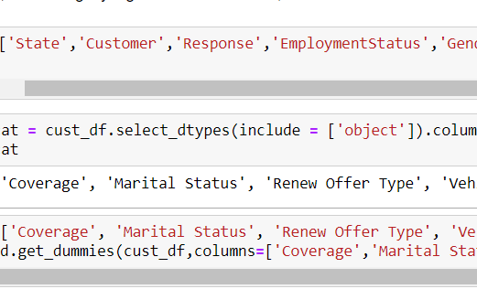
Feature Selection (Categorical Variables) - cont
Here, Employment Status and Gender shows no significant variation.
We can say that people who are educated(doctor) have much less customer lifetime value, when compared to the people who studied high school or below.
With all these findings, removed all the unwanted columns and applied dummy encoding for the categorical variables.

Slide 15
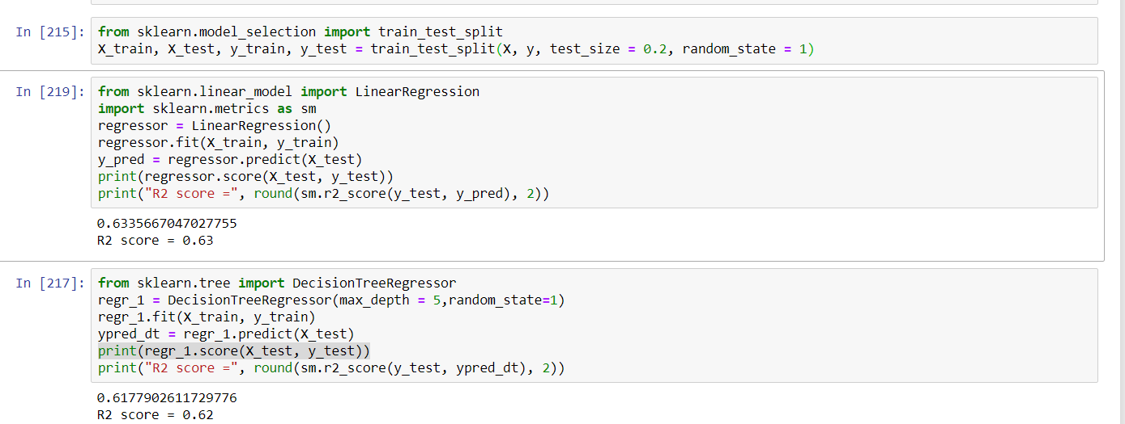
Model Selection
Linear Regression and Decision tree Regressor:
With the selected features, trained the Linear Regression model and achieved a score of 63.3%
Built a Decision tree regressor (max depth = 5) model with a score of 61.1%

Slide 16
Conclusion
Predicting CLV helps the business to plan for the future, in terms of investing amount on a particular customer.
. With CLV, they can assume whether their best customer in the past going to be best in the future
With EDA, It helps them to identify the issues and retain their customers.
Because it costs 10 times less to sell to an existing customer than to find a new customer.

Slide 17
Thank you

